Slide 1


C.R.U.D
Create – Read – Update - Delete

Slide 2

Apa itu “SQL” ?
Structured Query Language
“Sebuah bahasa yang digunakan untuk berkomunikasi dengan database”.
Notes:
Notes to presenter:
Description of what you learned in your own words on one side.
Include information about the topic
Details about the topic will also be helpful here.
Tell the story of your learning experience. Just like a story there should always be a beginning, middle and an end.
On the other side, you can add a graphic that provides evidence of what you learned.
Feel free to use more than one slide to reflect upon your process. It also helps to add some video of your process.

Slide 3
Basic Query
SELECT column FROM table WHERE conditions
INSERT INTO table (col1, col2, col3) VALUES (‘val1’, ‘val2’, ‘val3’)
UPDATE table SET col1 = ‘val1’, col2 = ‘val2’ WHERE conditions
DELETE FROM table WHERE conditions
Notes:
Notes to presenter:
Description of what you learned in your own words on one side.
Include information about the topic
Details about the topic will also be helpful here.
Tell the story of your learning experience. Just like a story there should always be a beginning, middle and an end.
On the other side, you can add a graphic that provides evidence of what you learned.
Feel free to use more than one slide to reflect upon your process. It also helps to add some video of your process.

Slide 4
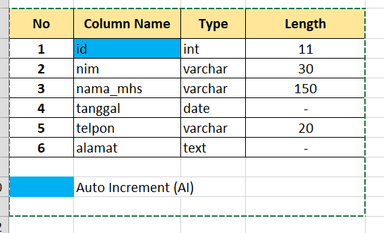
Let’s Practice!

Slide 5
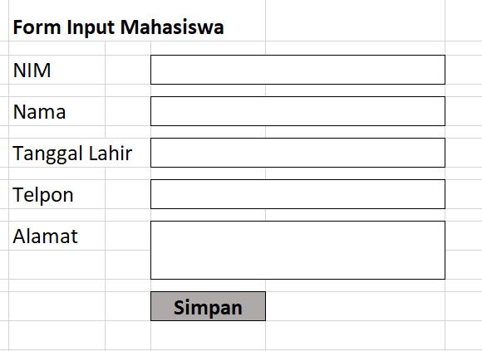
Layout the Form

Slide 6
See you later!

